Slide 1
Chapter II Vocabulary of Statistics
Basic Concepts
Those new to statistics sometimes find its terminology difficult so at this stage it is important to understand some new words and concepts.
This chapter sets out to provide meaning to some of the basic terms which are essential in carrying out statistical analysis.

Slide 2
Some of the Statistical Expressions
Data: Data refers to any group of measurements that helps in providing information.
Quantitative Data: Data that possess numerical properties are known as quantitative data.
Qualitative Data: Qualitative data reflects non-numeric features or qualities of experimental units. Ex: colour, gender, good, high, low.
Statistics: Statistics is the use of data to help the decision-makers to reach better decisions.
Variable: A variable is a characteristic that may take on different values at different times, places or situations. Ex: income, wages, population, no. of SHGs, political parties, voters.

Slide 3
Basic concepts CONSTANTS, Variables, Cases, Values Discrete and Continuous Variables Values Categorizing and coding the Variables Nominal scale Ordinal scale Interval scale Grouped and Ungrouped Data Descriptive statistics Inductive Statistics Multivariate Statistics Concepts of Distributions Frequency Distribution Probability Distribution Shapes of Distributions

Slide 4
Constants
In math and statistics, a constant is a number that is fixed and known, unlike a variable which changes with the context.
A symbol which has a fixed numerical value is called a constant. For example: 2, 5, 0, -3, -7 etc., are constants.
Constant is a specific number or a symbol that is assigned a fixed value. For example, in the equation below, "y" and "x" are variables, while the numbers 2 and 3 are constants.
y = 2x - 3

Slide 5
Variables, Cases, Values
In any study the researcher is concerned with a
particular population or universe.
Population refers to a specific group of people or
institutions or occurrences or observations about
which the researcher wishes to make descriptive
or analytical statements.
When resources are limited researcher will draw
sample observations either randomly or according
to some agreed strategy as the basis for
investigation.

Slide 6
Variables
We must define characteristics of population or
sample units to understand the sample or
universe in a better way. Each characteristic of a
population is termed as variable because these
are attributes which vary between cases.
Variable is a characteristic that may take on
different values for different cases at different
times, places or situations. Ex: incomes of
different individuals, votes obtained by different
political parties, population of different small
towns, no. of SHGs in each district etc.

Slide 7
Example:
Cases: Individuals such as X, Y, Z
Variables: Their respective gender is variable
since it is varying among individuals, Male= 1,
Female = 2
For some variables we can have more number of
categories.
Example: Number of children in a family
Cases: Family X, Y, Z
Variables: Their respective number of children is the
variable. Number of children may vary from ‘Zero to one
child, two children and so on.

Slide 8
Discrete and Continuous Variables
A variable may be either continuous or discrete. A
continuous variable is, capable of manifesting every
conceivable fractional value within the range of possibilities,
such as height or weight of persons (Ex. 55.6, 60.4, 72.8
K.G).
On the other hand, a discrete variable is that which can
vary only by ‘finite’ jumps and cannot manifest every
conceivable fractional value.
In some categories the values cannot logically be subdivided. For example the number of children in a family can only take certain values such as 1, 2 or 3, size of the family etc.

Slide 9
Values
These are the possible outcomes for a single Variable. They are
different for the different cases. Values can be numbers or
named categories. For example the variable Gender has two
values, "male" and "female". Some people (cases) are men, and
some are women.
Example:
Cases: Individuals such as X, Y, Z
Variables: Their respective gender is variable since it is varying
among individuals, Male= 1, Female = 2.
Values: values for the variable gender are 1 & 2 which are
assigned or coded for our convenience.
In the case of ‘incomes’ values are actual numbers:
For Case X, Income is the Variable and Rs.25,000/-is the Value.
For Case Y, Income is the Variable and Rs.34,000/- is the Value.

Slide 10
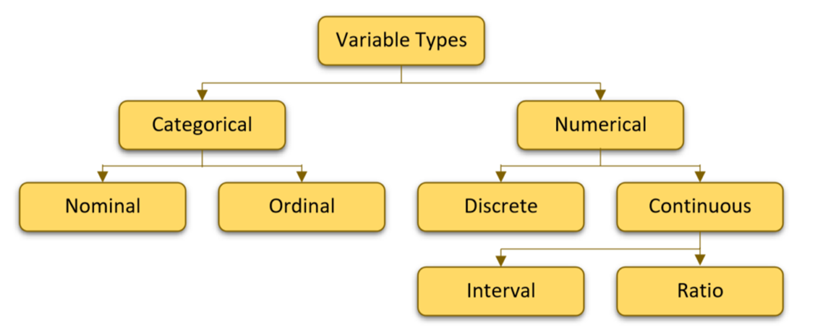
Types of variables

Slide 11
Categorizing and coding the Variables
An important stage of the research process is the allocation of a
numerical values to each variable.
This is called coding, for example non-literates= 0 and literates= 1.
The very process of coding facilitates the researcher to categorize the
population or sample observations.
Categorical variables:
Categorical variables have values that describe a 'quality' or
'characteristic' of a data unit, like 'what type' or 'which category'.
There are four levels of measurement or scales to measure the
variables.
a) Nominal scale: Variables measured on the nominal scale are
essentially qualitative rather than quantitative in form.
The values of variables are categories not mere numbers and cannot
be ordered in any mathematically meaningful way.

Slide 12
A nominal variable with only two possible values is referred to as a dichotomous variable. An example might be if we asked a person if they owned a mobile phone. Here, we may categorize mobile phone ownership as either "Yes" or "No".
We can as well have more categories for a variable, such as religious belief. These are called polytomous variables.
Hindu 1
Muslim 2
Christian 3
Buddhist 4
Here in nominal scale each value of the variable represents a category, they imply no particular order or relationship between the values.

Slide 13
b) Ordinal scale:
Nominal scale of measurement permits only classification of the observations into different categories, whereas ordinal scale of measurement permits the ordering of those categories into ranks or scale.
We can distinguish between the values in terms of degree but cannot measure the degree of difference between them.
Example: A group of workers opinions about the work environment.
Very poor 0
Poor 1
Satisfactory 2
Good 3
Very good 4

Slide 14
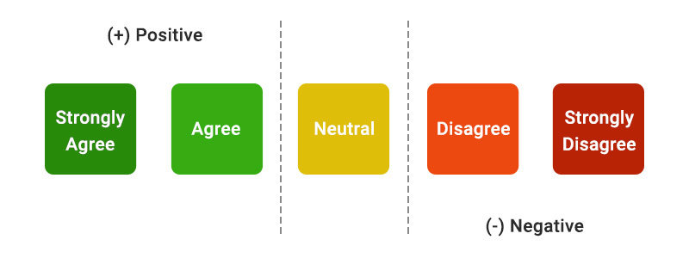

Slide 15
c) Interval scale: Interval scale implies both an ordering of categories and a measure of the distance between them. The differences between points on the scale are measurable and exactly equal.
Example: Number of absents each employee had in an
organization in a month.
No absences 0
One day 1
Two days 2
Three days 3 and so on.
The number of days here are categories which are ordered and allows us to measure exactly in a standard unit that three days is more than one day but less than six days. Four days absence is twice as many as two days and so on.

Slide 16
d) Ratio scale:
A ratio scale is a quantitative scale where there is a true zero and equal intervals between neighboring points.
Unlike on an interval scale, a zero on a ratio scale means there is a total absence of the variable you are measuring.
Ex: Length, area, and population are examples of ratio scales.
Ratio scales are one of the most common ways to depict scale on maps. It tells the map reader that one unit on the map is equal to a certain number of units in the real world. Example: 1:2500. For example, 1:2500 means that 1 cm = 2500 cm

Slide 17
Few more examples:
Income, height, weight, unemployment rate, and crime rate are examples of ratio data. As an analyst, you can say that a crime rate of 10% is twice that of 5%.
A ratio data example can be, that the weight of 90 kg is twice 45kg. No negative value: On a ratio scale there cannot be any negative value. The zero is the starting point in a ratio scale which means numerical value less than zero cannot exist. For example, a person cannot have negative height.

Slide 18
Age is typically considered to be measured on a ratio scale. This is because age has a true zero point, which means that a value of zero represents the absence of age.
In addition, it is possible to perform mathematical operations such as addition, subtraction, multiplication, and division on age values.
The most common examples of ratio scale are height, money, age, weight etc.

Slide 19
difference between interval vs ratio scale
The difference between interval vs ratio scale comes from their ability to dip below zero. Interval scales hold no true zero and can represent values below zero. For example, you can measure temperatures below 0 degrees Celsius, such as -10 degrees.
Ratio variables, on the other hand, never fall below zero.

Slide 20
Attributes:
An attribute refers to the quality of a characteristic.
The theory of attributes deals with qualitative types of characteristics that are calculated by using quantitative measurements.
Therefore, the attribute needs slightly different kinds of statistical treatments, which the variables do not get.
For example, eye color is an attribute of a person.
Attributes refer to the characteristics of the item under study, like the habit of smoking, or drinking. So ‘smoking’ and ‘drinking’ both refer to the example of an attribute.
In statistics classifying data based on attributes or characteristic is known as qualitative classification of data. Example of attributes are region, caste etc.

Slide 21
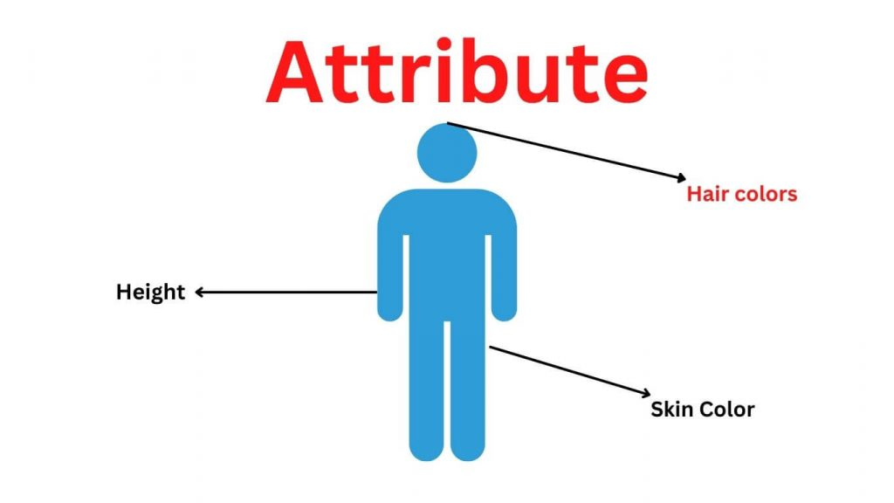

Slide 22
Grouped and Ungrouped Data
Ungrouped Data: The data obtained in original form are
called raw data or ungrouped data.
Example: The marks obtained by 25 students in a class in a
certain examination are given below;
25, 8, 37, 16, 45, 40, 29, 12, 42, 25, 14, 16, 16, 20, 10, 36,
33, 24, 25, 35, 11, 30, 45, 48.
This is ungrouped data which is in original form without any
ordering or grouping.

Slide 23
Grouped Data
To put the data in a more condensed form, we make
groups of suitable size, and mention the frequency of each
group. Such a table is called a grouped frequency distribution
table. Here we aggregate or group the data into ordered
categories.
Employees age No. of cases
16-20 years 47
21-30 years 95
31-40 years 67
41-50 years 71

Slide 24
Descriptive statistics
Descriptive statistics provide a concise summary of data. We
can summarize data numerically i.e. in the form of tables or
graphically in a meaningful way by using descriptive statistics.
Example: Marks obtained by students in a class.
Statistic | value
Mean | 65
Standard deviation | 7
Range | 14
N (sample size) | 50

Slide 25
Descriptive statistics summarize and organize characteristics of a
data set. A data set is a collection of responses or observations
from a sample or entire population.
In quantitative research, after collecting data, the first step of
statistical analysis is to describe characteristics of the
responses, such as the average of one variable (e.g., age), or the
relation between two variables (e.g., age and creativity).

Slide 26
Typically, there are two general types of descriptive statistics
That are used to describe data apart from tables and graphs.
a) Measures of central tendency: To describe the
characteristic of the entire mass of heavy data with a single
value we use descriptive statistics such as Mean, median and
mode.
b) Measures of spread: To understand scatter, spread or
Variation we use measures of spread or measures of variation
such as Range, quartiles, absolute deviation, variance
and standard deviation.

Slide 27
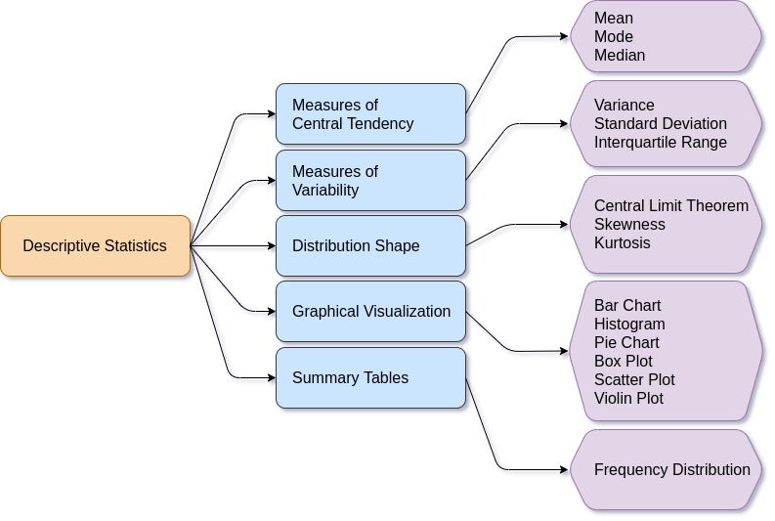

Slide 28
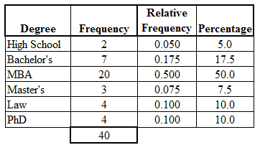

Slide 29
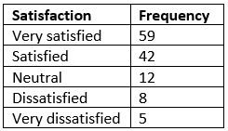

Slide 30
Inductive Statistics
The branch of statistics dealing with generalizations, predictions, estimations and arriving at conclusions based on data from sample is called inductive statistics.
When we do this we are inducing or inferring the characteristics of the population from the characteristics of the sample.
The purpose of inductive statistics is to assist the researcher to assess how representative a sample is from the population. Inductive statistics are also commonly called inferential statistics.
Example: alpha=0.05

Slide 31
Here in inductive statistics we discuss the
Following:
Why we use sample
Various sampling procedures such as random and non-random sampling methods
Random sampling error, bias
Estimating the population mean from the sample mean, normal distribution, standard error, confidence levels, testing of hypothesis etc.
Concepts of Distributions

Slide 32
Bivariate Statistics
Bivariate analysis is a statistical method examining how two different variables are related. The bivariate analysis aims to determine if there is a statistical link between the two variables and, if so, how strong and in which direction that link is.
It is one of the simplest forms of statistical analysis, used to find out if there is a relationship between two sets of values. It usually involves the variables X and Y.

Slide 33
Bivariate analysis is the analysis of exactly two variables.
Multivariate analysis is the analysis of more than two variables.

Slide 34
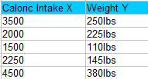
The results from bivariate analysis can be stored in a two-column data table. For example, you might want to find out the relationship between caloric intake and weight.

Slide 35
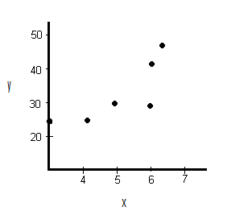
Types of Bivariate Analysis
Scatter plots:
These gives you a visual idea of the pattern that your variables follow.

Slide 36
Correlation Analysis:
Correlation analysis, also known as bivariate, describes the relationship between two variables or two sets of data.
This relationship can be perfect positive, strong positive, weak positive, no correlation (Zero), weak negative, strong negative, or perfect negative.

Slide 37
Regression Analysis:
Regression analysis is a statistical method that shows the relationship between two variables in bivariate analysis.
Regression Analysis usually expressed in a graph, the method tests the relationship between a dependent variable against independent variables.

Slide 38
Multivariate Statistics
Multivariate statistics is a subdivision of statistics about the simultaneous observation and analysis of more than one variable.
Example: Four of the most common multivariate techniques
are multiple regression analysis, factor analysis, path analysis
and multiple analysis of variance or MANOVA, ANOVA.

Slide 39
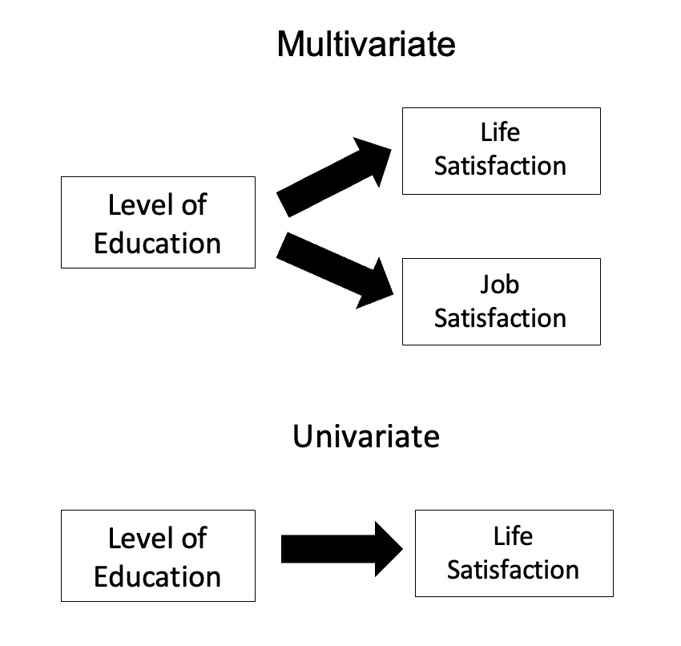

Slide 40
Concepts of Distributions
Frequency Distribution
Frequency distribution is a representation, either in a graphical or tabular format that displays the number of observations within a given interval. Ex: bar diagram
A frequency distribution refers to data classified on the basis of some variable that can be measured such as population(students, employees, farmers), wages, age etc.
Frequency tables often used to create histograms and frequency polygons. The following are two examples of discrete and continuous frequency distributions.

Slide 41
Ex: Discrete Variable Ex: Continuous Variable
No.of Children | No.of Families
0 | 10
1 | 40
2 | 100
3 | 15
Weight (Kg’s) | No.of Persons
40-50 | 20
50-60 | 45
60-70 | 40
70-80 | 25

Slide 42
Probability Distribution
For a discrete random variable, a probability distribution
contains the probability of each possible outcome. The sum
of all probabilities is always 1.0.
Examples of discrete random variables include the number of children in a family, the Friday night attendance at a cinema, the number of defective light bulbs in a box.
Examples of Probability Distributions: Binomial distribution,
Poisson distribution(discrete), Normal distribution (continuous
probability distribution).

Slide 43
Shapes of Distributions
Distributions have different shapes. A distribution with the longer tail extending in the positive direction is said to have a positive skew. It is also described as "skewed to the right”.
Some distributions have a negative skew. Since the tail of the distribution extends to the left, this distribution is skewed to the left.

Slide 44
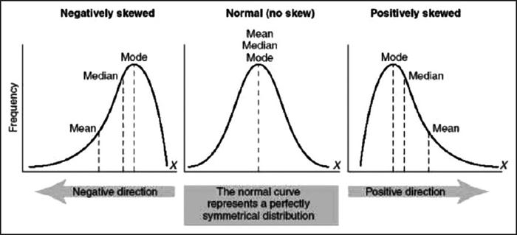

Slide 45
Skewness tells us the direction of outliers. In a positive skew, the tail of a distribution curve is longer on the right side. This means the outliers of the distribution curve are further out towards the right and closer to the mean on the left.
The reason we get skewed distributions is because data is disproportionally distributed. Specifically, the majority of the data is clustered in one area, and there are one or more outliers away from the majority of the data. Outliers are data points that are unlike most of the rest of the data.

Slide 46
Thank You

Slide 47
Chapter-iii Types and Collection of Data
Secondary and Primary Data
Concepts of Cross-section, Time Series, Panel data-balanced and un-balanced
Tools of Collecting Primary Data
Questionnaires and Schedules
Editing and Coding

Slide 48
Collection of Data
Collection of data constitutes the first step in a statistical investigation. Utmost care must be exercised while collecting data because data constitute the foundation, on which the superstructure of statistical analysis is built.
Data may be obtained either from the primary source or the secondary source. A primary source is one that itself collects the data; whereas secondary source is one that makes available data which were collected by some other agency.

Slide 49

Primary and Secondary Data
Depending upon the source, statistical data are classified under two categories.
(i) Primary data
(ii) Secondary data

Slide 50
PRIMARY DATA
Primary data are obtained by a study specifically designed to fulfill the needs of the problem at hand.
Such data are original in character and are generated in large number of surveys conducted mostly by government and also by some individuals, institutions and research bodies.
For example, data obtained in a population census by office of the census commissioner are primary data.

Slide 51
SECONDARY DATA
Data which are not originally collected but rather obtained from published or unpublished sources are known as secondary data.
For example, for census commissioner census data are primary, whereas for all others who use such data, they are secondary.

Slide 52
Differences between Primary and Secondary data
The difference between primary and secondary data is only of degree. Data which are primary in the hands of one becomes secondary in the hands of another.

Slide 53
Differences:
Data are primary for the individual agency or institution collecting the data, whereas for the rest of the world the data are secondary.
A few examples would clarify the distinction between primary and secondary data. Suppose an investigator wants data about the spending habits of the students of a university.

Slide 54
If he or she collects the data himself/herself or through his/her agents by interviewing the students or circulating a questionnaire then the data would constitute primary data for them.
On the other hand, if the students union has already made a similar survey and the investigator obtained data from students union office such data is called secondary data for him or for her.
Similarly statistics collected by various departments of the government such as Labour Bureau and Central Statistical Organisation (C.S.O), Bureau of Economics and Statistics are primary for the respective departments whereas for all others they constitute secondary data.

Slide 55
Sources of Secondary Data
In most of the studies the investigator finds it impracticable to collect firsthand information on all related issues and as such he makes use of the data collected by others.
There is vast amount of published information from which statistical studies may be made.
The sources of secondary data can broadly be classified under two heads.
(i) Published sources
(ii) Unpublished sources

Slide 56
Published Sources
1) Reports and official publications of various bodies viz.
International bodies such as the World Bank, International Labour Organisation (ILO), United Nations (UN).
Central and State Governments reports such as Statistical Abstracts.
Reports of the Committees and Commissions appointed by government such as Narasimham committee on banking sector, Seventh pay commission etc.

Slide 57
2) Semi-official publications of various local bodies such as Municipal Corporations and District Boards.
3) Publications of prestigious journals by universities and institutes such as Indian Journal of Agricultural Economics, Indian Economic Review, Reserve Bank of India Bulletin etc.
4) Annual Reports of R.B.I, NABARD, Stock Exchanges, Corporations etc.
5) Publications brought out by various autonomous research institutes such as Institute of Economic Growth, Delhi, National Council of Applied Economic Research (NCAER), Delhi, Centre for Economic and Social Studies (CESS), Hyderabad etc.

Slide 58
It should be noted that the publications mentioned above vary regard to the periodicity of publications.
Some are published at regular intervals (yearly, monthly, weekly etc.) where as others are ad-hoc publications i.e. with no regularity about periodicity of publication.

Slide 59
Unpublished Sources
All statistical material is not always published. There are various sources of unpublished data such as records maintained by various government and private offices.
Studies made by research institutes, scholars will fall under this category.

Slide 60
Cross-sectional data
Definition: Cross-sectional data is information that is gathered at one point in time to reflect social conditions.
Cross-sectional data, or a cross section of a population, in statistics is a type of data collected by observing individuals, firms, countries, or regions at some point of time, or without regard to differences in time.
Analysis of cross-sectional data usually consists of comparing the differences among the subjects (individuals, firms, countries, or regions).
Example: Number of habitations in a region in 1996.

Slide 61
For example, if we want to measure current obesity levels in a population, we could draw a sample of 1,000 people randomly from that population. This is also known as a cross section of that population.
If we measure their weight and height, and calculate what percentage of that sample is categorized as obese.
This cross-sectional sample provides us with a snapshot of that population, at that point of time. Note that we do not know based on one cross-sectional sample if obesity is increasing or decreasing; we can only describe the current proportion.

Slide 62
Time Series data
Time series data differs from cross-sectional data, in which units of observations are observed at various points of time.
A time series is a collection of observations made sequentially through time. The interval between observations can be any time interval (hours within days, days, weeks, months, years, etc).

Slide 63
Some areas of applications:
Time series can occur in a wide range of fields from economics to sociology, meteorology, geography to financial investment, etc
Some examples of time series are:
- Malaria incidence or deaths over calendar years, Covid-19 cases.
- Daily maximum temperatures
- Hourly records of babies born at a maternity hospital
Can you suggest other examples?
Air pollution

Slide 64
Thank You

